Slide 1
Goal:
Data
Work Practices
•
•
•
•
•
People
Technology
Value:
Notes:
WCA TEMPLATE

Slide 2
Value Added

Slide 3

G.S.W. Solutions
“Connecting Your Business to the World”
Website Development Plan
Consultants
Allison Guy
Robby Sanford
Tara Wright

Slide 4
Table of Contents

Slide 5
Table of Contents

Slide 6
Executive Summary

Slide 7
Team Overall WCA
Goal:
Data
Work Practices
•Research and develop work steps
•Produce specifications for a website that adds business value to the client
•Deliver a published website that meets the client’s specifications
•Service the client by ensuring that they have a maintainable website
•Sell the client the proposal and secure a contract
•Client specifications
•Instructions on how to use the development tool
•Design specifications
•Contents of service agreement
•Contract
·Project Objectives
To develop a plan for securing a contract with a client
Project Plan
Team members
People
•Programmers
•Client
•Project Lead
Value:
Technology
A structured plan will make the process of securing a contract with a client better and faster
•Computers
•Internet
•Email
•Development Tool
Notes:
WCA TEMPLATE

Slide 8
Team Overall WCA Narrative
The customer of our overall WCA or the team portion of the project is all of the members of our project team. The overall goal is to develop a plan to secure a contract with the client. A structured plan that makes the process of securing that contract with our client better and faster will asset the business value for the members of our team.
Client specifications, instructions on how to use development tools, design specifications, the contents of a service agreement, and project objectives are the data resources we used. The people involved in this stage are the client, project lead, and programmers. Technology resources included computers, the internet, e-mail, and the development tool.
The first step in the work practices is research and develop a list of work steps we would need in order to develop the individual websites. Then produce a list of specifications for a website that adds business value to the client followed by delivering a published website that meets the specifications of the client. We will ensure that they client’s website is maintainable for the service phase and sell the client the proposal and secure a contract. These work practices prepare our product of the overall WCA as the project plan.

Slide 9
Team Overall VC
Research
Produce
Deliver
Service
Sell
Information to develop work steps
Design specifications
Published website
Maintainable website
Signed Contract
Value Added
A structured plan will make the process of securing a contract with a client better and faster

Slide 10
Team Overall VC Narrative
Overall Goal of the Value Chain: Develop a plan of action for securing a contract with the client
Research work steps necessary to complete the website project
Produce a list of specification for the website that adds business value to the client
Deliver a published website the meets the specifications of the client
Service the client by ensuring that they have a website that is maintainable
Sell the client the proposal that will secure the contract
Business Value Delivered: A structured plan will make the process of securing a contract with the client better and faster

Slide 11
Team Research WCA
Goal:
Data
Work Practices
•Research what information needs to be gathered in order to develop the client’s website
•Produce questionnaire that will be used to gather the required information
•Sell the project team members the questionnaires for approval
•Service the questionnaires by making any changes required by team members
•Deliver the questionnaires to the appropriate person
To develop questionnaires to assist in gathering required information
·Project objectives
Questionnaires
People
Team Members
·Client
·Team members
Technology
·Computers
·Internet
·Email
Value:
Provides a system for gathering information that can be followed by all team members
Notes:
WCA TEMPLATE

Slide 12
Team Research WCA Narrative
The customers of the research WCA for the team portion of the project are the team members. The goal of the research phase is to develop questionnaires to assist in gathering required information. Business value is added because the questionnaires provide a system for gathering information that can be followed by all team members.
The data required for the research phase are the project objectives. The people involved are the client and team members. The technology used includes computers, the Internet, and Email.
The first steps in the work practices is to research what information needs to be gathered in order to develop the client’s website. Next, questionnaires that will be used to gather the required information are produced and are sold to the team members for approval. The questionnaires are then serviced by making any changes required by team members. The final version of the questionnaires are then delivered to the appropriate person so they can be completed.

Slide 13
Team Research VC
Research
Produce
Sell
Service
Deliver
Knowledge of what information is needed
Team member’s approval
Final version of questionnaires
Required changes
Questionnaires
Value Added
Provides a system for gathering information that can be followed by all team members

Slide 14
Team Research VC Narrative
Goal of the Team Research Value Chain: To develop questionnaires to assist in gathering required information
·Research what information needs to be gathered in order to develop the client’s website.
·Produce questionnaire that will be sued to gather the required information.
·Sell the project team members the questionnaires for approval.
·Service the questionnaires by making any changes required by team members.
·Deliver the questionnaires to the appropriate person.
Business Value Delivered: Provides a system for gathering information that can be followed by all team members

Slide 15
Team Research Work Steps
Goal
A. What is the client’s goal for the website?
1. Have client sign off on the established goal using the Client Goal Verification Form.
B. How will this website add value to the client?
C. Who is the client’s target audience?
Content
A. What content does the client want on the website?
1. Does the client have a preferred color scheme? If so, what colors will be used?
2. What personal information does the client want published on the Internet?
B. What method(s) of navigation will be used on the website?
1. Does the client want a hit counter on the website?
C. What pictures/images/logos will be used on the website?
1. Have client agree and sign off on a deadline to have all of these to project lead.
D. Does the client have a preferred URL and is it available? What are the 2nd and 3rd choices in case it is not available?
E. Is the client satisfied with the content that will be used on the website? If so, have the client sign off on this phase of the development using the Client Approval Form.
.

Slide 16
Team Research Work Steps
III. Technical
A. Where will the website be hosted?
1. How do you publish a website using this host?
a. What is the username/password required to publish the website?
2. What are the host’s restrictions regarding file size?
B. What website development tools are available?
1. Which one will be used to publish the website?
a. Is this development tool supported by the host?
b. Where can the software/download for this tool be found?
c. What are the system requirements for this development tool?
d. Where can a tutorial on the use of this development tool be found?
C. Will the website be published under the client’s account or G.S.W.’s account?
1. If being published under the client’s account, what information do you need from the client in order to do so?
a. Have client/project lead sign confidentiality agreement upon client giving
project lead access to username/password.
IV. Page Layouts
A. What page layouts/site maps are appropriate?
1. Have client approve and sign off on these.
B. If applicable, what hit counter will be used on the website?
1. Is this application fee based or a free service?

Slide 17
Team Produce WCA
Goal:
To produce a website that adds business value to the client
Data
Work Practices
• Research what content the client wants on the website • Produce page layouts and site map
•Sell the page layouts and site map to the client for approval
• Service the page layouts and site map by making any changes required by the client
• Deliver design specifications to programmers
•Client specifications
Design Specifications
People
Programmers
•Client
•Project Lead
•Programmer
Technology
Value:
Design specifications that facilitate publishing of the client’s website are produced
•Computers
•Email

Slide 18
Team Produce WCA Narrative
For our team’s produce WCA the customers are the programmers. The decided goal is to produce a website that adds business value to our client. The ability to add business value comes from the design specifications that facilitate publishing of the client’s website that are produced.
The only data resource necessary for the produce phase was the desired specifications of the client. The people involved are the client, project lead and programmers and the only technology we found necessary was computers and e-mail.
The first step in the work practices is research what content the client wants on the website. Next we should produce page layouts and a site map. We will then sell the page layouts and site map to the client for approval. Followed by servicing the pay layouts and site map by making any changes required by the client. Finally we will deliver the final design specifications to the programmers. The product that is produced in this page is the design specifications for the programmers.

Slide 19
Team Produce VC
Research
Produce
Sell
Service
Deliver
Page layouts and site map
Changes to page layouts and site map
Website content
Client’s approval
Design specifications
Value Added
Design specifications that facilitate publishing of the client’s website are produced

Slide 20
Team Produce VC Narrative
Overall Goal of the Value Chain: To produce a website that adds business value to the client.
Research the content that the client would like to be included in their website
Produce page layouts and site map
Sell the page layouts and site map to the client for approval
Service the page layouts and sitemap by making any changes required by the client
Deliver design specifications to the programmers
Business Value Delivered: Design specifications that facilitate publishing of the client’s website are produced

Slide 21
Team Deliver WCA
Goal:
Data
•Design specifications
•Instructions on how to use the development tool
Work Practices
•Research how to use the development tool to create a website
•Produce or publish the website
•Deliver the website address to client so they can view the final product
•Service the website by making any changes required by the client
•Sell the final product by getting the client’s final approval
To publish a website that meets the specifications of the client
Published website
People
•Programmers
•Project Lead
•Client
Client
Technology
•Development Tool
•Computers
•Email
Value:
By having a website, the client is better able to achieve their business goal.

Slide 22
Team Deliver WCA Narrative
For our team’s produce WCA the customer is the client. The decided goal of the phase is to publish a website that meets the specifications of the client. By having a website, the client is better able to achieve their goal and increase their business value.
The data resources necessary here are the design specifications and instructions on how to use the development tool. The people involved are the programmers, project lead and the client. The technology we used is the development tool, computers, and e-mail.
We began work practices for the deliver phase by researching how to use the development tool in order to create the website. Then we will produce or publish the website after designing it with the development tool of our choice. Then we will deliver the website address to the client so they can view the final product. We will service the website by making any changes the client feels are necessary. Finally we will sell the final product by getting the client’s final approval. The product returned to the customer of this phase, the client, is the published website.

Slide 23
Team Deliver VC
Research
Produce
Deliver
Service
Sell
Knowledge of Development Tool
Published website
Client specified modifications
Modified website
Client’s approval
Value Added
By having a website, the client is better able to achieve their business goal.

Slide 24
Team Deliver VC Narrative
Overall Goal of the Value Chain: To publish a website that meets the specifications desired by the client
Research how to use the development tool in order to create the website
Produce or publish the website
Deliver the website address to the client so they can view the final product
Service the website by making any changes required by the client
Sell the final product by getting the client’s final approval
Business Value Delivered: By having a website, the client is better able to achieve their business goal

Slide 25
Team Service WCA
Goal:
Data
Work Practices
•Research what types of changes the client might need to make to the website in the future
•Produce guidelines to assist the client in making future changes to the website
•Deliver website documentation to client
•Sell the possibility of purchasing an extended service contract to client
•Service the client by fulfilling the service agreement contract
•Design specifications
•Contents of service agreement
To ensure the client has a maintainable website
Documentation
People
•Project Lead
•Client
•Programmers
Client
Technology
•Computers
•Internet
Value:
Having documentation better enables the client to update/make changes to their website
Notes:
WCA TEMPLATE

Slide 26
Team Service WCA Narrative
For our team’s deliver WCA the customer is the client. The goal of this phase is to ensure the client has a maintainable website. The business value is added because having documentation better enables the client to update or make changes to their website.
The data resources used for the deliver phase are the design specifications and the contents for the service agreement. People involved during this phase are the project lead, client and the programmers. We used computers and the internet as technology resources.
We began work practices for the service phase by researching what types of changes the client might need to have made to the website in the future. Then we produce guidelines to assist the client in making future changes to the website. Next we will deliver website documentation to the client and sell the possibility of purchasing an extended service contract to them. We will proceed to service the client by fulfilling the service agreement contract. The product yielded to the client in this phase is the documentation we developed.

Slide 27
Team Service VC
Research
Produce
Deliver
Sell
Service
Expected future changes
Guidelines for changes
Website documentation
Contract for extended service
Updated website
Value Added
Having documentation better enables the client to update/make changes to their website

Slide 28
Team Service VC Narrative
Overall Goal of the Value Chain: To ensure the client has a maintainable website
Research what types of changes the client might need to make to the website in the future
Produce guidelines to assist the client in making future changes to the website
Deliver website documentation to the client
Sell the possibility of purchasing an extended service contract to the client
Service the client by fulfilling the service agreement contract
Business Value Delivered: Having documentation better enables the client to update or make changes to their website

Slide 29
Team Sell WCA
Goal:
Data
Work Practices
•Research client’s specific wants and needs
•Produce suggestions and reasons why the client should hire G.S.W. Solutions to develop their website
•Deliver the business proposal for developing the client’s website
•Sell the contract to the client
•Service the contract by making any changes as requested by the client
To secure a contract with the client
•Contract
Signed Contract
People
Client
•Client
•Project Lead
Technology
•Computers
•Email
•Internet
Value:
The guidelines set forth in the contract make that website better for the client by assuring it will meet their expectations
Notes:
WCA TEMPLATE

Slide 30
Team Sell WCA Narrative
For the sell WCA for our team the customer is the client. The goal we are seeking is to secure a contract with the client. The guidelines set forth in the contract make that website better for the client by assuring it will meet their expectations and will increase the business value of our client.
The only data resource we found necessary for the sell phase is the contract. The people that should be included are the client and the project lead. As for technology we will use computers, e-mail and the internet.
The first step in the work practices is to research the client’s specific wants and needs. For the contract, we will produce suggestions and reasons why the client should hire G. S. W. Solutions to develop their website. We will deliver the business proposal for developing the clients website. The next thing to do would be to actually sell the contract to the client. Finally we will service the contract by making any changes requested by the client. The product returned to the client for the sell phase would be the signed contract.

Slide 31
Team Sell VC
Research
Produce
Deliver
Sell
Service
Client’s wants and needs
Business proposal for website development
Make changes requested by Client
Reasons to choose G. S. W.
Contract
Value Added
The guidelines set forth in the contract make that website better for the client by assuring it will meet their expectations

Slide 32
Team Sell VC Narrative
Overall Goal of the Value Chain: To secure a contract with the client
Research the client’s specific wants and needs
Produce suggestions and reason why the client should hire G. S. W. Solutions to develop their website
Deliver the business proposal for developing the client’s website
Sell the contract to the client
Service the contract by making any changes as requested by the client
Business Value Delivered: The guidelines set forth in the contract make that website better for the client by assuring it will meet their expectations

Slide 33
G.S.W. Solutions
602 12th Street Suite D
Tuscaloosa, AL 35401
205-246-6372
Client Approval Form
_____________________, client, has reviewed the work of G.S.W. Solutions regarding the _______________ of the working project and hereby affirms that all requirements have been addressed and successfully met. The client further agrees that beyond this ____ day of ________, 2006, if any requests are made for modifications to the above mentioned portion of the working project, additional charges will be incurred.
__________________ ________________
Client Signature Date
__________________ ________________
G.S.W. Representative Date

Slide 34
G.S.W. Solutions
602 12th Street Suite D
Tuscaloosa, AL 35401
205-246-6372
Client Goal Verification Form
____________________, client, and G.S.W. Solutions agree that the goal of the proposed website is ______________________________
________________________________________________________. Furthermore, the client agrees that if the goal/purpose of the website being developed by G.S.W. Solutions should change beyond this ____ day of _________, 2006, additional charges may be incurred.
________________________ _________________
Client Date
________________________ _________________
G.S.W. Representative Date

Slide 35
G.S.W. Solutions
602 12th Street Suite D
Tuscaloosa, AL 35401
205-246-6372
Deadline for Submitting Pictures/Images/Logos
The client agrees to have all pictures/images/logos that he/she wishes to be used on the website to G.S.W. Solutions on or before the ______ day of _________, 2006. If this deadline is not met, the client understands that he/she may incur additional charges.
_________________ _______________
Client Date
_________________ _______________
Project Lead Date

Slide 36
G.S.W. Solutions
602 12th Street Suite D
Tuscaloosa, AL 35401
205-246-6372
Username/Password Confidentiality Agreement
G.S.W. Solutions agrees to use the client’s username/password only for publishing the website and agrees not to disclose this information to anyone other than the G.S.W. Solutions’ employees necessary to complete the project.
_________________ _______________
Client Date
_________________ _______________
Project Lead Date

Slide 37
G.S.W. Solutions
602 12th Street Suite D
Tuscaloosa, AL 35401
205-246-6372
Contract
G.S.W. Solutions is hereby employed by ___________________, to develop a website. G.S.W. Solutions will conduct research on the client’s goals and will use information gathered during the research phase and from the client in order to facilitate website development. G.S.W. Solutions further agrees that the project will be completed on or before the _____ day of _______, 2006.
_________________ _______________
Client Date
_________________ _______________
Project Lead Date

Slide 38
G.S.W. Solutions
602 12th Street Suite D
Tuscaloosa, AL 35401
205-246-6372
Extended Service Agreement
The client chooses to purchase an extended service agreement from G.S.W. Solutions.
Please choose from the following:
6mo. Extended Service - $299.95
1yr. Extended Service - $499.95
Lifetime Service - $700.00
Extended Service will include any needed updates of the website brought to the attention of G.S.W. Solutions by the client. Extended Service does not include a complete redesign of the website at any time.
_________________ _______________
Client Date
_________________ _______________
Project Lead Date

Slide 39
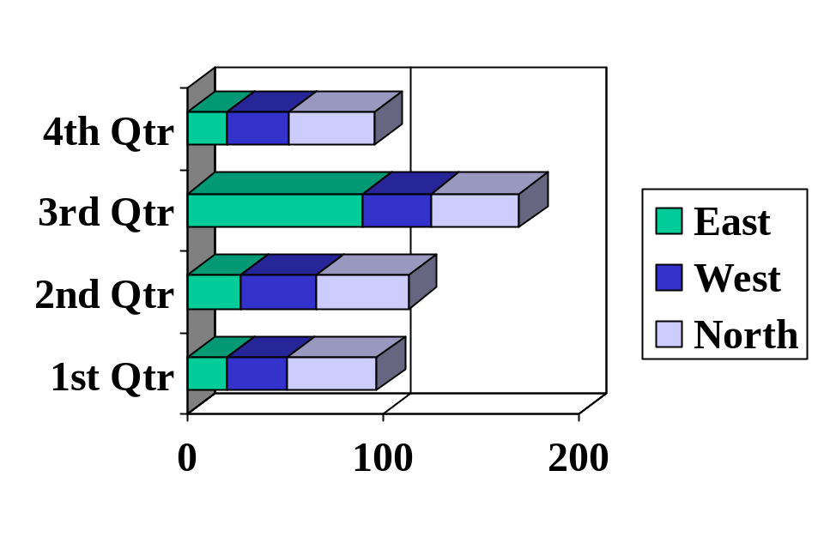
GANTT CHART
Days
60

